Slide 1
Reinforcement Learning Markov Decision Process

Slide 2
Topics
Markov Process
Markov Reward Process
Markov Decision Process
Extensions of MDP

Slide 3
Markov Process
Markov Process formally describe an environment for reinforcement learning.
Where the environment is fully observable.
The current state completely characterizes the process.
Almost all RL problems can be formalized as MDPs.

Slide 4
Markov Process
Many problems can be a special case of MDP.
Partials observable problems can be converted into MDPs.
Bandits are MDPs with one state.

Slide 5


Markov Process: Markov State
A State is Markov (has Markov property) if and only if
The state captures all relevant information from the history.
Once the state is known, the history can be thrown away.

Slide 6
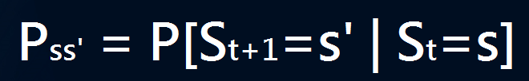
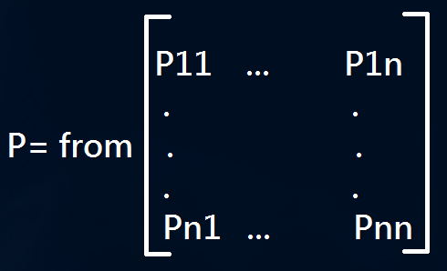
Markov Process : State Transition Matrix
For a Markov state s and successor state s’, the state transition probability is defined by
State Transition Matrix P defines transitions probabilities from all states s to all successor states s’.
Each row of the matrix sum to 1.

Slide 7
Markov Process
A Markov process is a memoryless random process.
(i.e. a sequence of random state S1, S2…with Markov property)
A Markov Process(or Markov chain) is a tuple (S, P)
S is a (finite) set of states
P is a state transition probability matrix

Slide 8
Markov Process: Example
0.9
Wechat
Sleep
1.0
Pass
Sample Episodes fro Student Markov Chain starting from S1=C1
C1 C2 C3 P S
C1 W W C1 C2 S
C1 C2 C3 D C2 C3 P S
C1 W W C1 C2 C3 D C1 C2 C3 S
0.5
0.1
0.2
0.6
Class 1
0.5
Class2
0.8
Class3
0.4
0.4
0.4
0.2
Date

Slide 9
Markov Process: Example
0.9
Wechat
Sleep
1.0
Pass
 | C1 | C2 | C3 | Pass | Date | Wechat | Sleep
C1 | - | 0.5 | - | - | - | 0.5 | -
C2 |  |  | 0.8 |  |  |  | 0.2
C3 |  |  |  | 0.6 | 0.4
Pass |  |  |  |  |  |  | 1.0
Date | 0.2 | 0.4 | 0.4
Wechat | 0.1 |  |  |  |  | 0.9
Sleep |  |  |  |  |  |  | 1.0
0.5
0.1
0.2
0.6
Class 1
0.5
Class2
0.8
Class3
0.4
0.4
0.4
0.2
Date

Slide 10
Markov Reward Process

